Slide 1
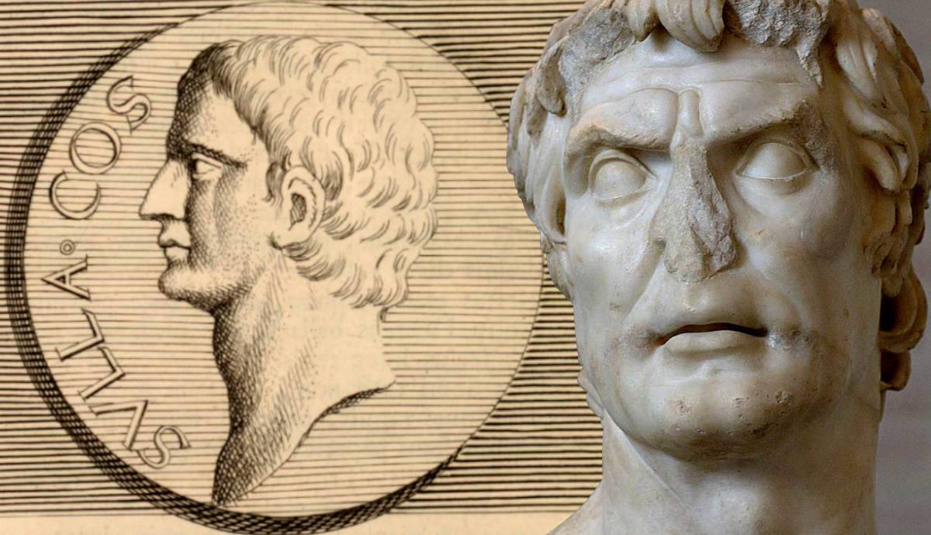
Second March on Rome
GOAL/S: Describe the causes and effects of Sulla’s Second March On Rome
Week 3, Lesson 2

Slide 2
Reflection
Task mark report

Slide 3
ACTIVITY – Sulla: Historical Context
Watch the following video: https://www.youtube.com/watch?v=Cz2vs2rZIt4
Discussion: What do you already know about Sulla’s FIRST March on Rome?

Slide 4
In 88 BCE, Lucius Cornelius Sulla (138 - 78 BCE) marched on Rome and entered the city's sacred inner boundary, the pomerium, bearing arms. Breaking this taboo, he sought to gain political power and control of the army of the East that had been offered to his enemy, Gaius Marius (c. 157 - 86 BCE). A second march occurred in 83 - 82 BCE when he assumed the title of dictator.

Slide 5
Key Information
Context: The Roman Republic faced political turmoil and power struggles during the 1st century BCE.
Key Players:
Lucius Cornelius Sulla: A Roman general and politician.
Gaius Marius: A rival general and political opponent of Sulla.

Slide 6
REVIEW – First March on Rome
First March on Rome (88 BCE)
Cause: Sulla’s eastern army was offered to his rival, Gaius Marius.
Action: Sulla broke the taboo by marching on Rome, entering the sacred inner boundary (pomerium) with armed forces.
Result: Sulla sought political power and control over the army of the East.

Slide 7
The Second March on Rome
Cause: Sulla’s desire for power and revenge against Marius.
Action: Sulla assumed the title of dictator and marched on Rome again.
Battle of Colline Gate: Sulla’s forces defeated Marius loyalists, including around 50,000 soldiers.
Consequences: Sulla’s rule was characterized by ruthless consolidation of power

Slide 8
ACTIVITY – The Second March on Rome
Read through the information sheet as a class
Write a paragraph summary about the Second March on Rome (10 min)

Slide 9
Battle of Colline Gate
The Battle of the Colline Gate took place on 1 November 82 BCE during the civil war between Lucius Cornelius Sulla and the Marians, Samnites, and Lucanians. Here are the key details:
Location: The battle occurred near the Colline Gate, which is on the northeastern wall of Rome.
Result: Sulla emerged victorious, securing control of Rome and Italy.
Opposing Forces:
Sulla’s Army: Led by Lucius Cornelius Sulla himself.
Samnites and Lucanians: These forces were led by Pontius Telesinus.
Significance: The Battle of the Colline Gate marked the decisive moment in Sulla’s campaign to consolidate power and establish his authority in Rome.
Appian is the primary source providing details about this pivotal battle.
After his victory, Sulla ordered the slaughter of Marian leaders and Samnite prisoners in the Villa Publica, followed by the proscription of his enemies

Slide 10
Key Information
Precedent: Sulla’s unprecedented use of a Roman army against the city set a dangerous precedent for future civil conflicts.
Reforms: Sulla enacted reforms, including proscriptions (targeted killings) of political enemies.
Legacy: His actions left a lasting impact on Roman politics and governance.
Significance: Sulla’s Second March on Rome marked a turning point in Roman history.
Discussion: Was Sulla’s pursuit of power justified, or did it lead to unnecessary bloodshed?

Slide 11
SUMMARY
Describe ONE (1) positive impact and ONE (1) negative impact of Sulla’s Second March on Rome.

